Slide 1

Designing for Neurodiversity: Sensory-Inclusive Environments
Miguel Castillo
Notes:
In this session, I’ll be presenting on Designing for Neurodiversity: Sensory-Inclusive Environments. My interest in this topic started when I came across the news article about LEGOLAND resorts in North America becoming Certified Autism Centers found on the class resources. This sounded interesting and I became curious in understanding what this meant? how would this it impact individuals on the spectrum?
As I learned more about the topic, I became aware of the sensory processing differences. I was surprised by how much everyday environmental stimuli can affect neurodivergent individuals. So, I wanted to share what I learned.
I think understanding these sensory differences can help designers create more inclusive and comfortable experiences for a wide range of people.

Slide 2
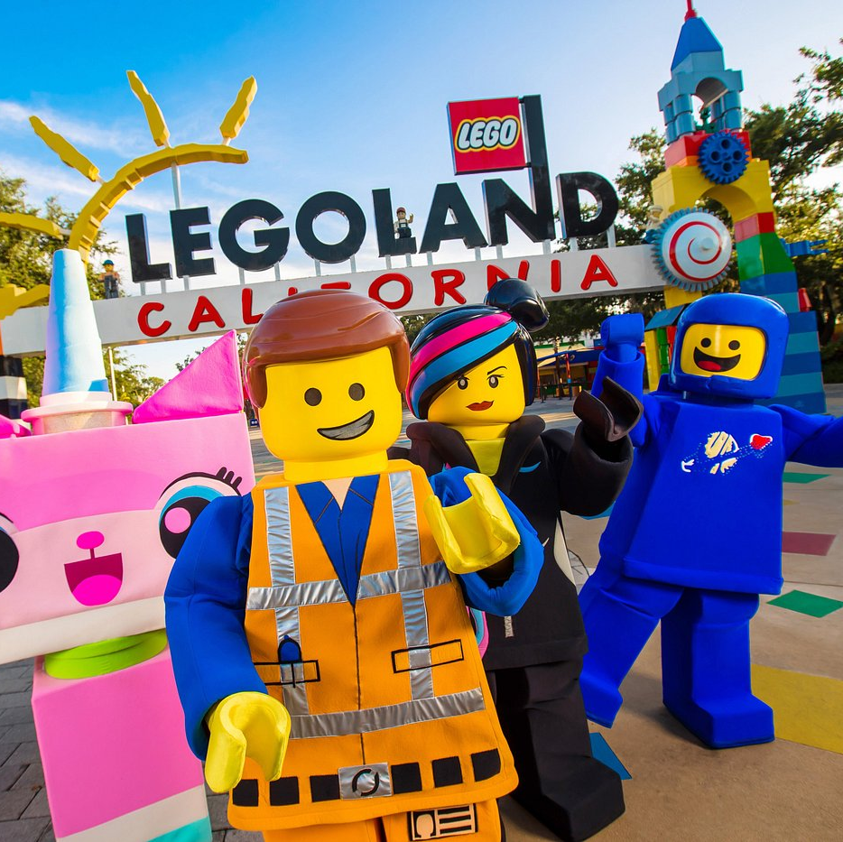
LEGOLAND Certified Autism Center
LEGOLANDS in North America considered Certified Autism Center
Certified by the International Board of Credentialing and Continuing Education Standards (IBCCES)
Employee training
Low sensory rooms
Sensory guides
Notes:
I assume everyone knows what LEGOLAND is, but if not, it’s basically a theme park with rides and shows, similar to Disneyland or Universal Studios.
As of 2023, all LEGOLAND resorts in North America have been designated as Certified Autism Centers.
LEGOLAND partnered with the International Board of Credentialing and Continuing Education Standards (IBCCES) to achieve this certification across its theme parks, water park, and on-site hotels.
This means the board provided them evidence-based training, onsite reviews, and customized recommendations.
This board worked with the resort to conduct a staff-wide autism sensitivity and awareness training. This ensures team members are equipped to better assist individuals on the spectrum or those with other sensory sensitivities.
Additionally, they ensured designated spaces on-site provide quiet rooms and low-sensory areas, allowing guests with sensory sensitivities to take a break and relax in a less stimulating environment.
Also, the board conducted an in-depth review of the resort to help develop detailed Sensory Guides. These guides indicate whether there are bright lights, loud sounds, or other features guests might need to plan around.
I found this particularly interesting because it helps parents and/or those who are neurodivergent prepare well in advance to reduce uncertainty and anxiety, which I learned is a common practice among the community.

Slide 3
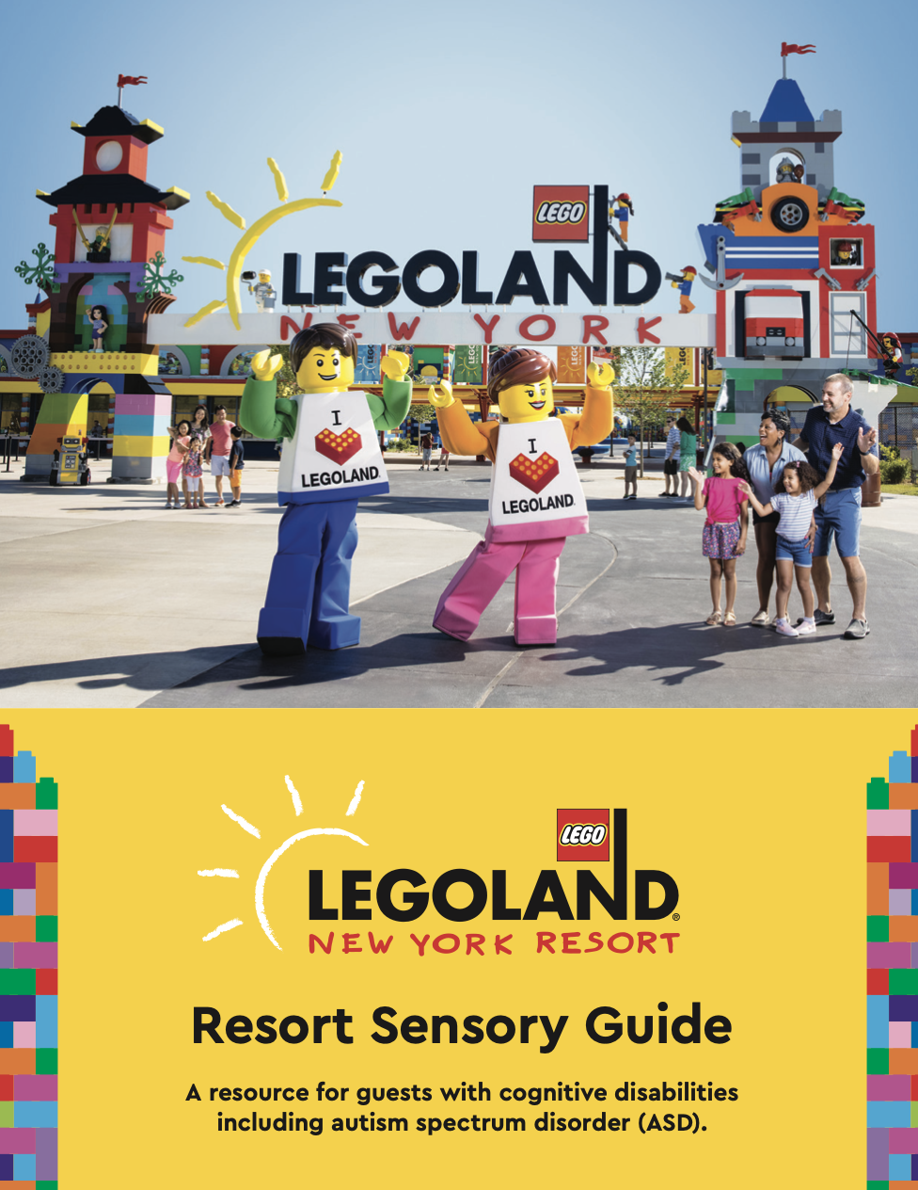
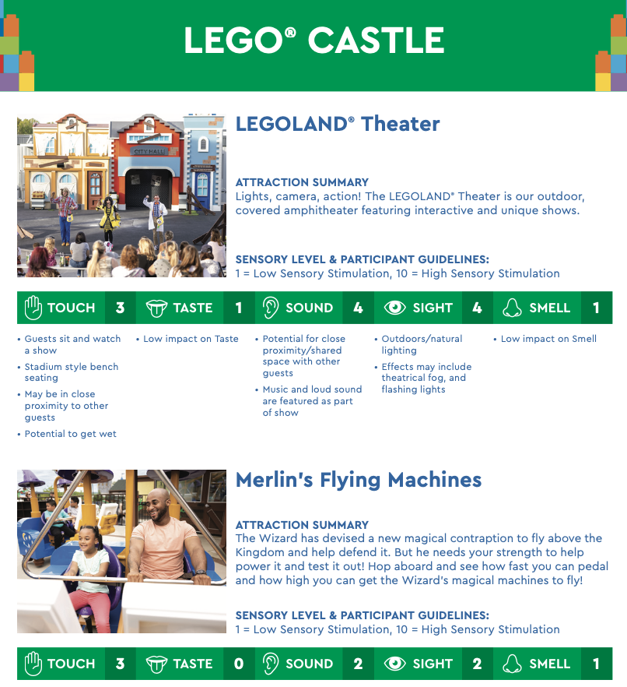
LEGOLAND Sensory Guide
Notes:
SENSORY LEVEL & PARTICIPANT GUIDELINES: 1 = Low Sensory Stimulation, 10 = High Sensory Stimulation
The guides are posted on each ride and on our website and mobile app.
This is the sensory guide for LEGOLAND in New York. As you can see it provides information about the individual attraction, and the sense rating for each of the sense with a description.
They indicate whether there are bright lights, loud sounds, or any features families might need to plan around.
Overall, it provides insight on how each attraction may affect each of the five senses.
By rating the sensory levels of each attraction – touch, taste, sound, sight, and smell – we make it easier for families to pre-plan activities that align with the needs of their children or themselves.
Guides also feature a Park map that indicates low-traffic areas for visitors needing a low-sensory break area.

Slide 4
Sensory Sensitive
Sensory Sensitive
People with sensory sensitivities experience sensory input more intensely or differently than others
Can be experienced by people of all ages and abilities. It can be temporary or permanent experience, and may co-occur with various diagnoses, or simple differences, including (but not limited to): Autism, ADHD, PTSD.
Neurodiversity
Neurotypical
Neurodivergent (Autism, ADHD, Dyslexia)
Notes:
As you can see, LEGOLAND’s implementations primarily address sensory sensitivity needs, which are often overlooked since most visitors do not require these accommodations to enjoy the resort.
These individuals are sometimes collectively referred to as Neurotypical:
A neurotypical person has neurocognitive functions (thinking and reasoning abilities) that align with societal norms and expectations.
So, who require these accommodations? LEGOLAND specifically mentions individuals on the autism spectrum and those with other sensory sensitivities. However, sensory sensitivity can affect people of all ages and abilities—whether temporarily or permanently—and may co-occur with various diagnoses, or simple differences, including (but not limited to): Autism, ADHD, PTSD.
These individuals are often grouped as Neurodivergent:
Neurodivergent refers to people whose neurocognitive functions diverge from societal norms and expectations.
However, many individuals have not undergone formal neurological assessment or do not fit neatly into one category. Even neurotypical individuals can be affected by elements of the built environment—for example, experiencing dizziness or headaches due to excessive sensory stimulation (auditory or visual noise).
To ensure inclusive and enjoyable experiences for everyone, designers and stakeholders must recognize the wide range of ways people experience and process the world due to neurodiversity.
This presentation primarily focuses on individuals on the autism spectrum—who frequently experience sensory processing differences— but the insights may also apply to anyone with sensory processing difference.

Slide 5
Sensory Processing Difference
Sensory processing is how information is perceived, processed and organized when received through the senses i.e., hearing, sight, smell, touch, taste and movement.
To have a sensory processing difference, is to react through the senses in a different way to the majority.
The reaction may be hypersensitive where the neurological reaction is high or overwhelming, or hyposensitive where the reaction is very low or underwhelming.
Notes:
Now,
As a refresher, Sensory processing is how information is perceived, processed and organized when received through the senses i.e., hearing, sight, smell, touch, taste and movement.
So, to have a sensory processing difference, is to react through the senses in a different way to the majority.
This reaction may be hypersensitive where the neurological reaction is high or overwhelming, or hyposensitive where the reaction is very low or underwhelming.

Slide 6
Hypersensitivity
Hypersensitivity
Heightened response to physical (via sound, sight, touch, or smell) and/or emotional stimuli and the tendency to be easily overwhelmed
Sensory Avoidance
Pulling away from physical touch
Covering the ears to avoid loud or unpredictable sounds
Avoiding certain kinds of clothing
Notes:
Hypersensitivity
We can think of hypersensitivity as Over stimulation
Heightened response to physical (via sound, sight, touch, or smell) and/or emotional stimuli and the tendency to be easily overwhelmed
For example, those with hypersensitivity may experience extreme feelings of being hot, cold, or pain. Certain lights, sounds, smells, textures and tastes can be overwhelming.
Hypersensitivity usually result in
Sensory avoidance
Pulling away from physical touch
Covering the ears to avoid loud or unpredictable sounds
Avoiding certain kinds of clothing

Slide 7
Hyposensitivity
Hyposensitivity
Reduced response to environmental stimuli
Ex: A need to touch things excessively, turning the volume very loud, etc.
Sensory Seeking
Making loud noises
Touching people or objects
Rocking back and forth
Notes:
Hyposensitivity
Little to no response from stimulus
Reduced response to environmental stimuli
Ex: A need to touch things excessively, turning the volume very loud, etc.
Ex: Can also look like a constant need for movement; difficulty recognizing sensations like hunger, illness or pain; or attraction to loud noises, bright lights and vibrant colors
Those with hyposensitivity usually engage in
Sensory Seeking
Making loud noises
Touching people or objects
Rocking back and forth

Slide 8
Sensory Overload
Sensory overload happens when one or more of the body’s five senses become overwhelmed. This leads to stress and anxiety.
It can happen, for example, in a crowded restaurant, when the radio is too loud, or when a passerby is wearing a strongly scented perfume.
Meltdown – behaviors vary; crying, yelling
Flight – individuals try to get away from sensory stimulus
Shutdowns – individuals become unresponsive
Notes:
Sensory overload happens when one or more of the body’s five senses become overwhelmed. This leads to stress and anxiety.
It can happen, for example, in a crowded restaurant, when the radio is too loud, or when a passerby is wearing a strongly scented perfume.
This can be triggered by a single event, like an unexpected loud noise, or it can build up over time due to the effort it takes to cope with sensory sensitivities in daily life. Sensory overload can feel like intense anxiety, a need to escape the situation or difficulty communicating.
As a response to sensory overload, individuals may have meltdowns, may want to escape/run away, and may also have shutdowns.
Meltdown
Overwhelming emotions that lead to behaviors that vary like becoming very verbal, crying and becoming more aggressive.
Flight
When the individual becomes overloaded, they will try to get away from the sensory information that’s causing the sensory overload
Shutdown
Shutdown due to sensory overload usually means the individual goes quiet and just stops processing information.

Slide 9
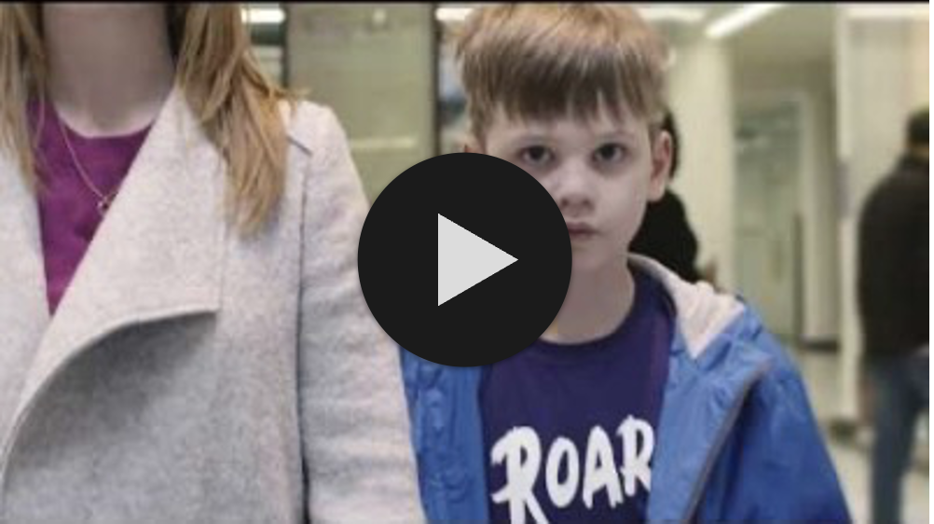
Sensory Overload – National Autistic Society
Notes:
This is a quick video representation of how a child with autism may experience a typical UK shopping center and how overwhelming it can become. The child finds it difficult to filter out noises and lights as he walks into the centre.

Slide 10
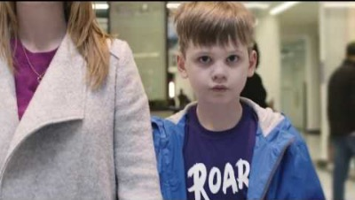
Sensory Overload – National Autistic Society

Slide 11
Environmental Triggers
Bright lights
Excessive noise
Smells
Crowds
Queues
Overly hot or cold environments
Notes:
Some of the most common environmental triggers that may cause sensory overloads or shutdowns.
bright lights
- no natural light
excessive noise
- background music
smells
- store perfumes
crowds
- no space
queues
- no way to bypass

Slide 12
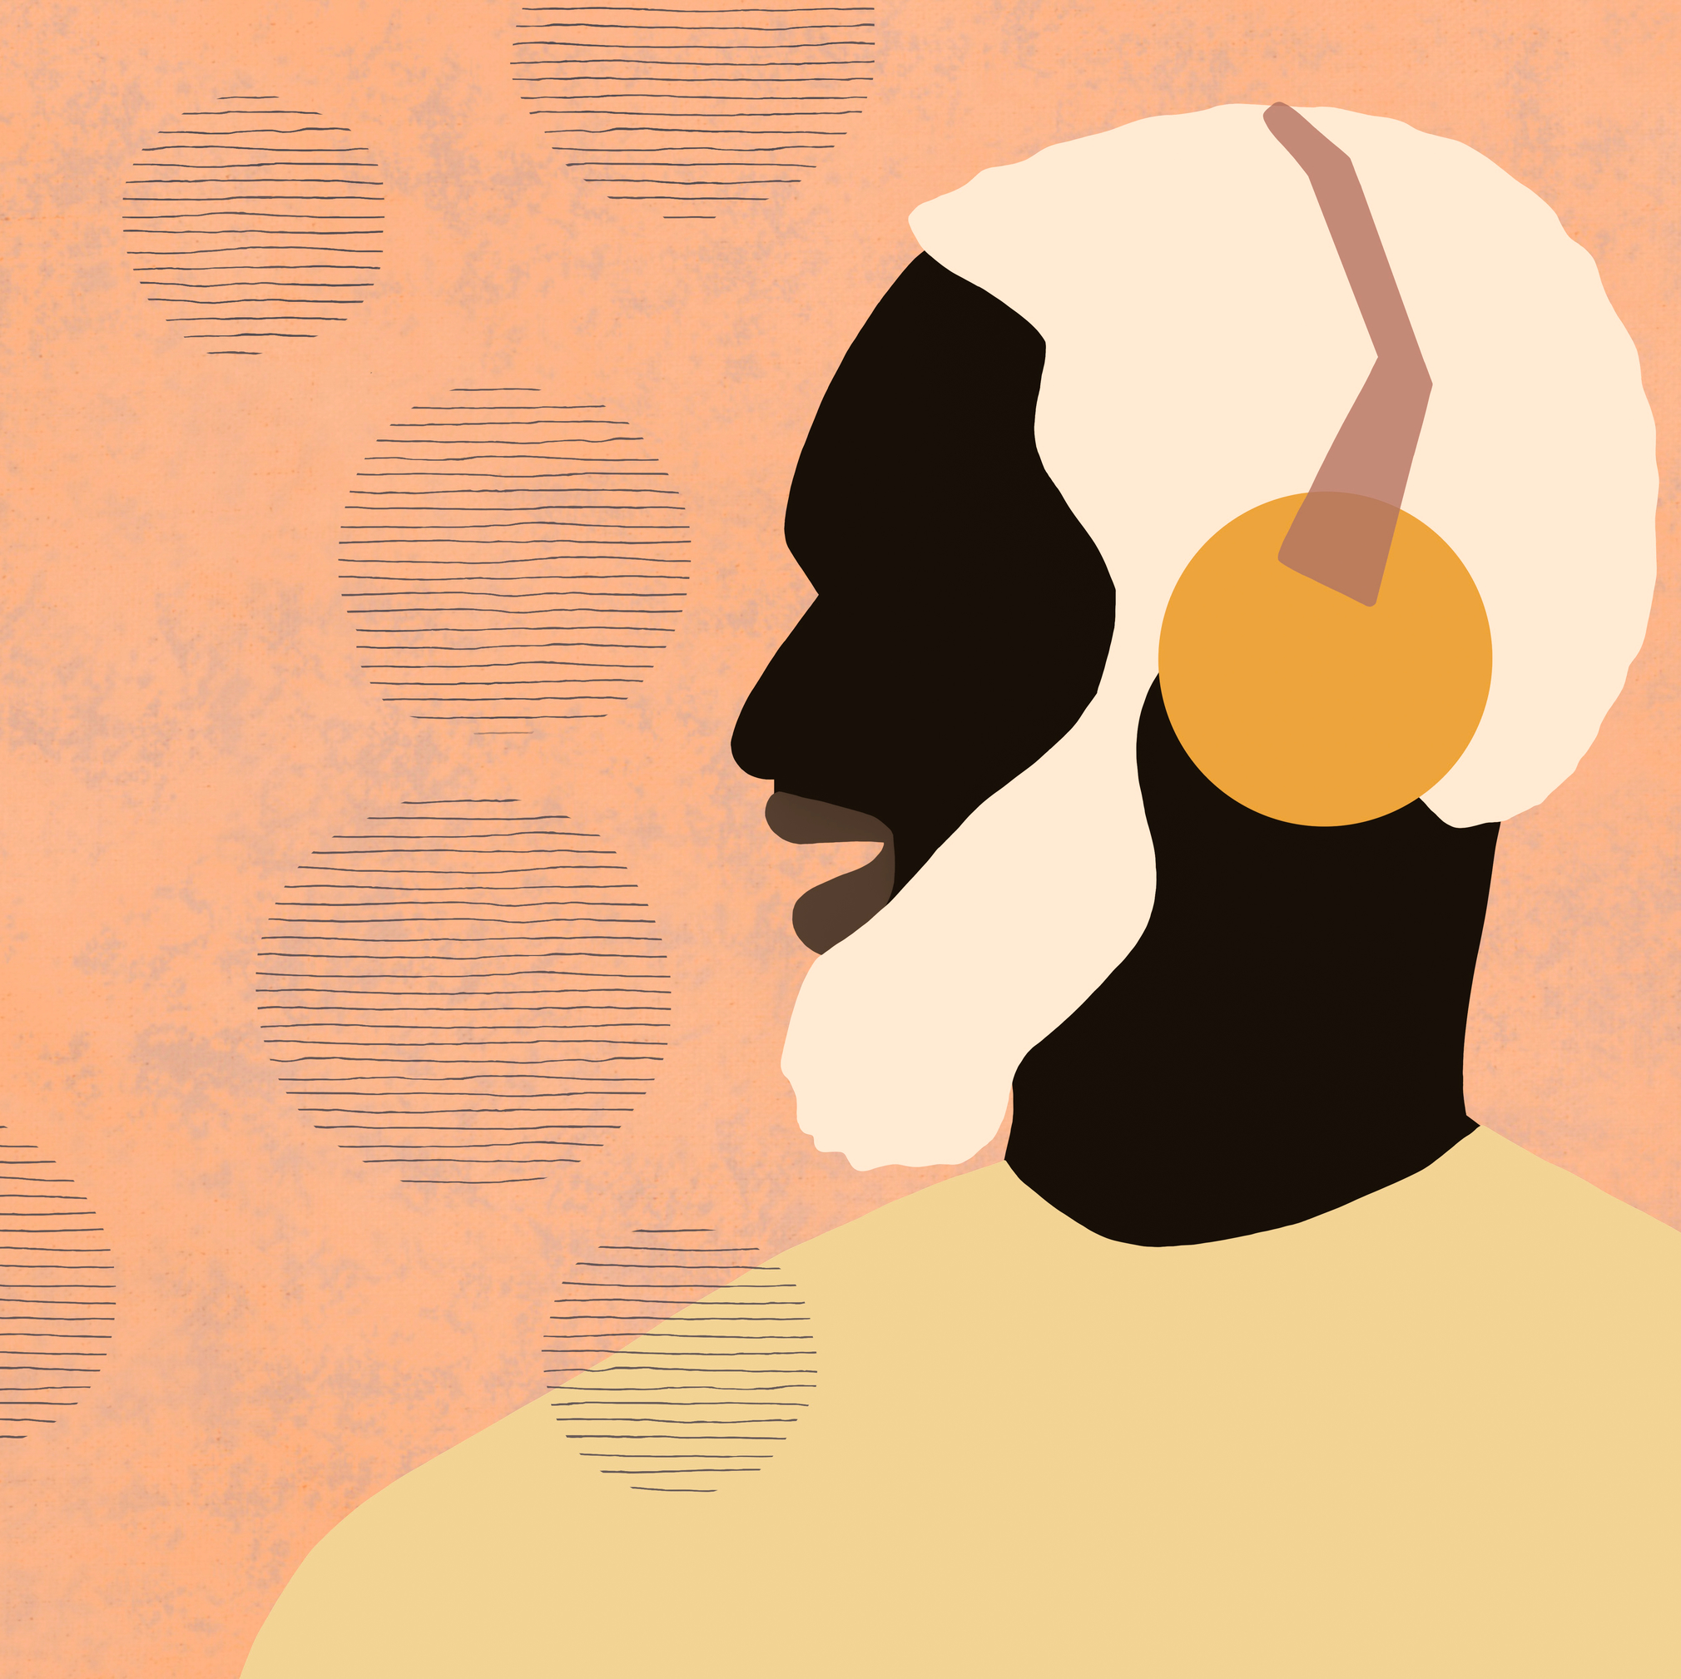
Environment Design Recommendations
Lights
Reduce light brightness
Avoid fluorescent lights
Have sunglasses available
Noise
Reduce volume of background music
Provide alternatives to noisy hand dryers
Have headphones or ear defenders
Notes:
Understanding and accommodating sensory issues can ease discomfort and increase opportunities for people to learn, socialize, communicate and participate in the community.
These considerations can apply to theme parks like LEGOLAND, supermarkets, restaurants, museums, etc.
There are many ways you can adapt your environment to minimize the risk of sensory overload.
Lights
reduce light brightness by dimming or turning off when possible OR have dedicated area to do so if not feasible for the entire building
Have sunglasses available
Noise
Reduce volume of background music through premises
Provide alternatives to noisy hand dryers like paper towels
Have headphones or ear defender available for people to use

Slide 13

Environment Design Recommendations
Scent
Adopt scent-free policy
Avoid using air fresheners or strong-smelling products
Touch
Offer fidget toys
Provide verity of seating with different textures

Slide 14
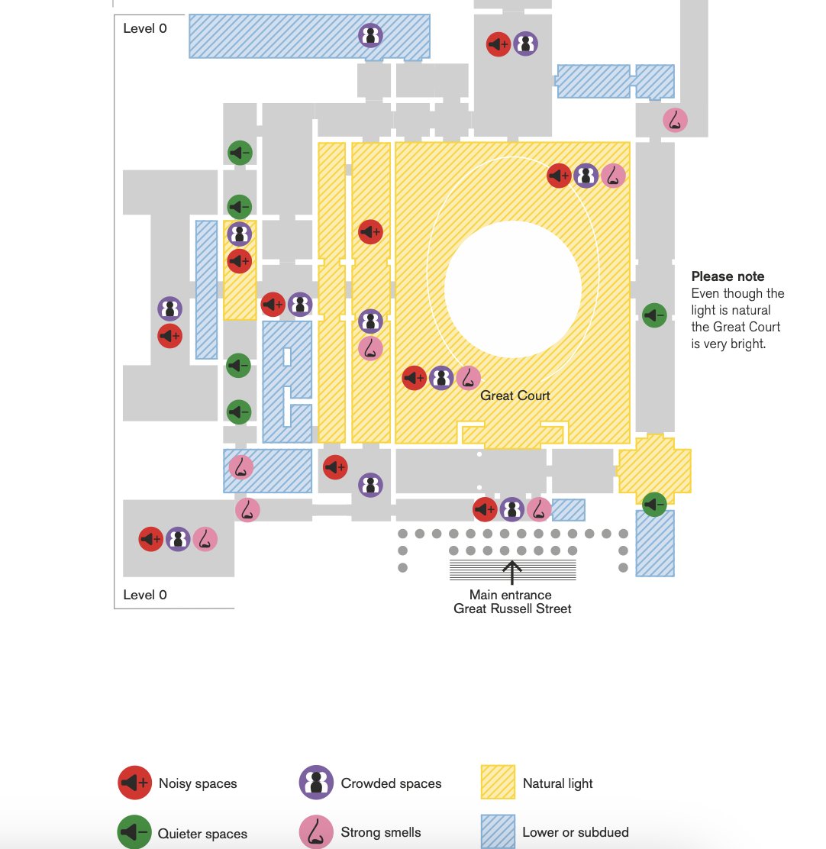
Environment Design Recommendations
Crowds and Queues
Provide busy hours and quieter times
If appropriate, allow people to bypass queues and large crowds
Maps
Help individuals prepare in advance
Sensory map stating areas that are bright or noisy

Slide 15
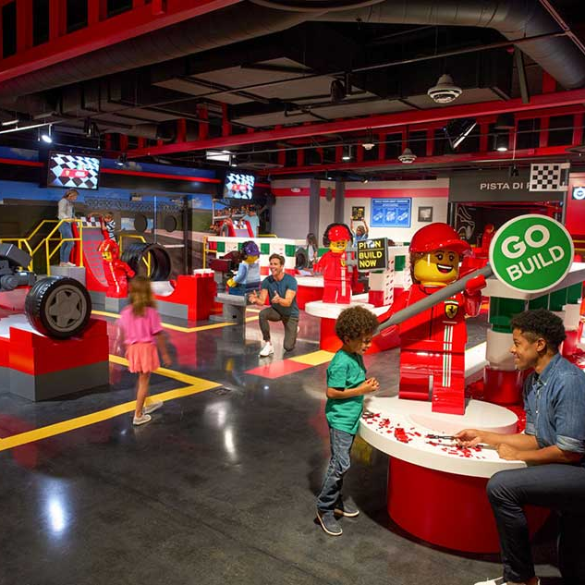
Environment Design Recommendations
Designate quite space
Quiet space away from main crowds with reduced noise and lightning
Such space could also feature soft seating and sensory toys, stress balls and games.
Dedicated hour
Organize a special hour during a less busy period just for autistic people where lightning is dimmed, and noise is reduced.
Notes:
Designated quite space
Quiet space away from main crowds with reduced noise and lightning when individuals and their companions can retreat to if an environment becomes too much.
Such space could also feature soft seating and sensory toys, stress balls and games.
Dedicated hour
- Organize a special autism hour during a less busy period, or this could be a quieter session just for autistic visitors where lighting is dimmed, and background noise is reduced. This could be a monthly event, opening an hour or two later or earlier than usual.
As an example: LEGO Ferrari Build & Race from 1pm to 2pm daily, offering a quieter experience.

Slide 16
PAS 6463 – Design Guide
PAS 6463: Design for the Mind – Neurodiversity and the Built Environment – Guide
Provides best practices for designing spaces that accommodate neurodivergent individuals, particularly those with sensory processing differences.
Published by the British Standards Institution (IBS)
Key areas covered
Site and building layout
Wayfinding
External spaces and access to nature
Internal layout
Mechanical, electrical, and power
Acoustics
Lightning
Surface finishes
Fixtures, fittings and furniture
Safety and recovery
Notes:
The recommendations above were gathered from various sensory sensitivity and autism-related resources. These are not specifically tailored for designers. But I did come across the PAS 6463 design guide: Design for the Mind – Neurodiversity and the Built Environment.

Slide 17
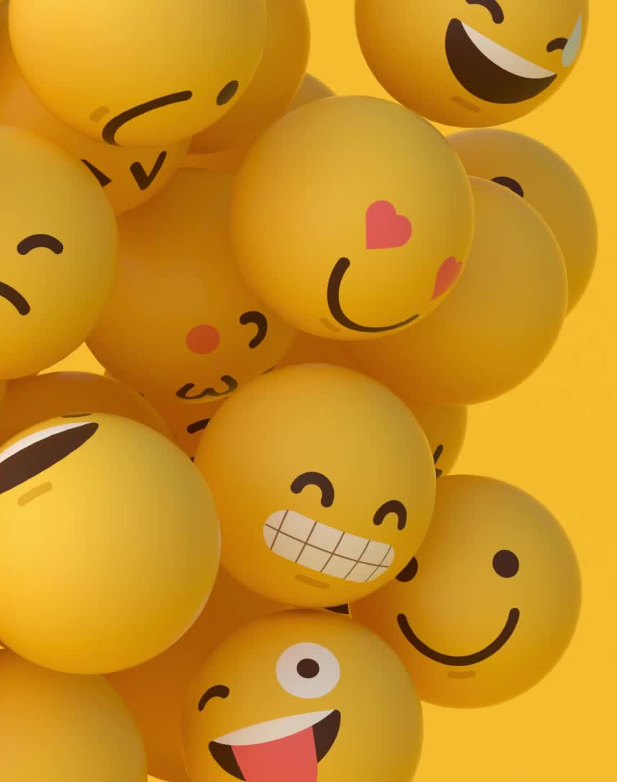
Thank you!
Thank you very much for your time! If you have any questions, please contact me via - cast4317@vandals.uidaho.edu

Slide 18
References
Accessible Environments. National Autistic Society. (n.d.). https://www.autism.org.uk/what-we-do/autism-know-how/autism-accreditation/autism-friendly-award/guides-and-resources/accessible-environments
Sensory Issues. Autism Speaks. (n.d.). https://www.autismspeaks.org/sensory-issues
GriffinOT. (2023, November 19). What is sensory overload and how can I support individual’s sensory needs. https://www.griffinot.com/what-is-sensory-overload/#:~:text=Running%20away%20(flight),get%20out%20of%20the%20space
Seeberger, C. (2024, November 27). What does it mean to be sensory sensitive?. Sensory Friendly Solutions. https://www.sensoryfriendly.net/what-does-it-mean-to-be-sensory-sensitive/#:~:text=Sensory%20sensitivity%20can%20be%20experienced,be%20present%20in%20various%20conditions
National Autistic Society. (2019, May 16). Can you make it to the end?. YouTube. https://www.youtube.com/watch?v=aPknwW8mPAM&t=84s
LEGOLAND Accessibility Information: https://www.legoland.com/california/plan-your-visit/know-before-you-go/accessibility-information/
PAS 6463 Guide: https://www.cibse.org/media/sgmfhexo/b_559_21_0089-design-for-the-mind.pdf

